Slide 1
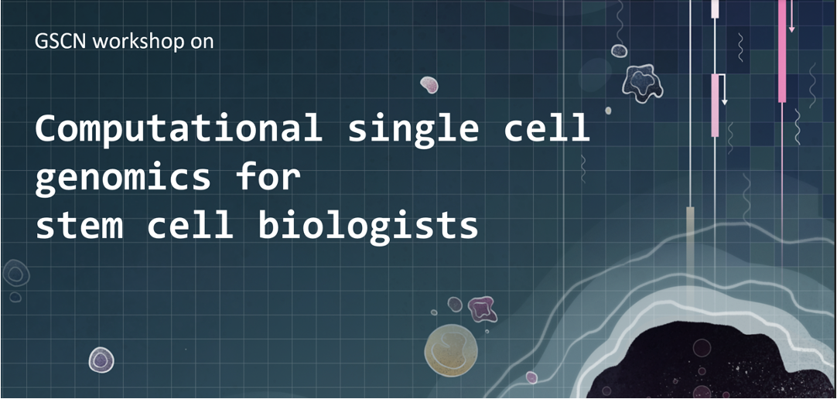
November 7 - 8

Slide 2






Computational single-cell genomics for stem cell biologists
Sara Jiménez
Machine learning group, CHC
November 8, 2024
sarajimenezc
sarajimenez

Slide 3
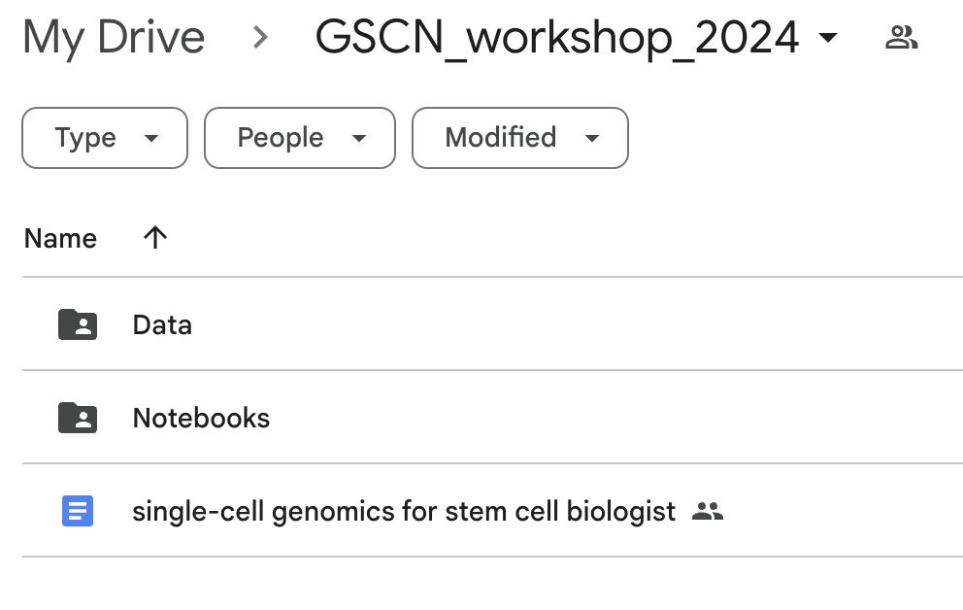
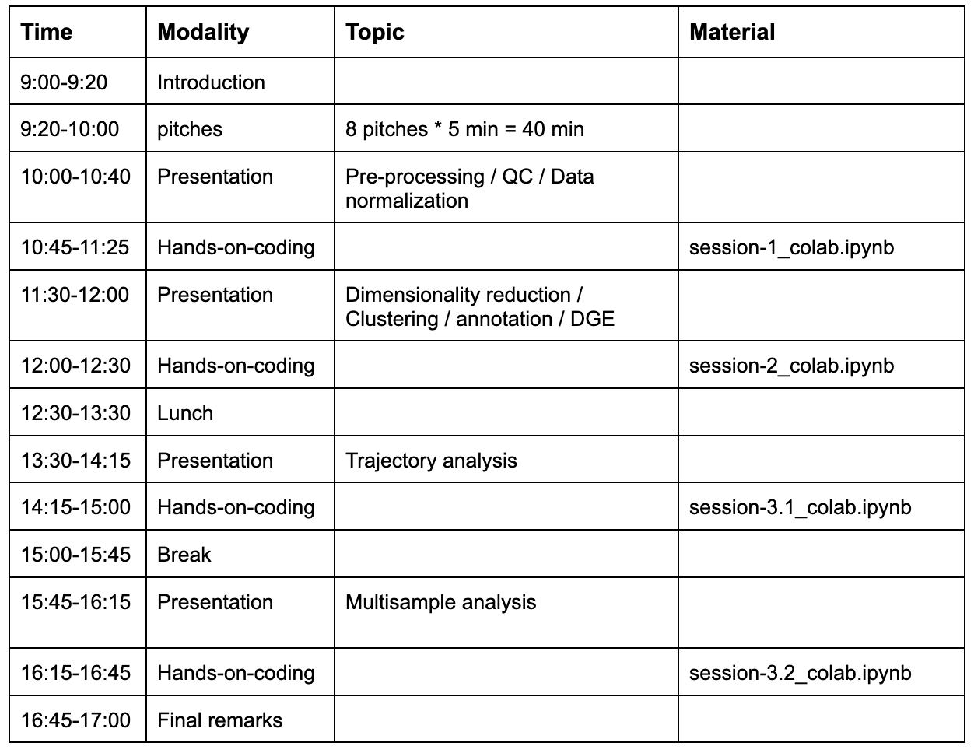
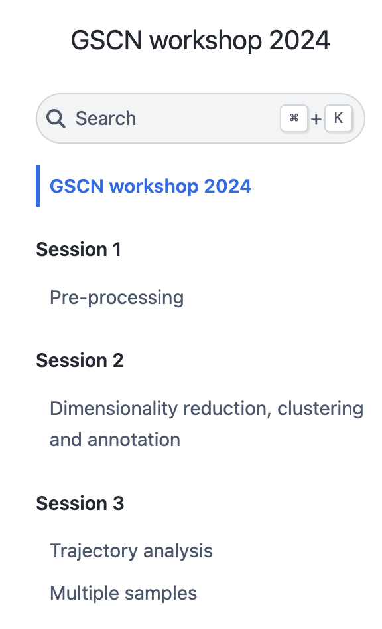
Overview of this workshop
✅
✅
✅
https://sarajimenez.github.io/GSCN_workshop_2024/
✅
✅
✅

Slide 4
Recap
Library size distribution; Number of uniquely expressed genes per cell
scRNA-seq data matrix
Pre-process and QC
Number of cells each gene is expressed in
Visualization: tSNE, UMAP, Force Directed Layout
MT-content
Doublet Detection
Clustering: PhenoGraph, Leiden
Graph
PCA, dimensionality reduction
Data Normalization (Median library size + log transformation)
Imputation
Differential Expression, GSEA
Trajectory Inference, Factor Analysis

Slide 5
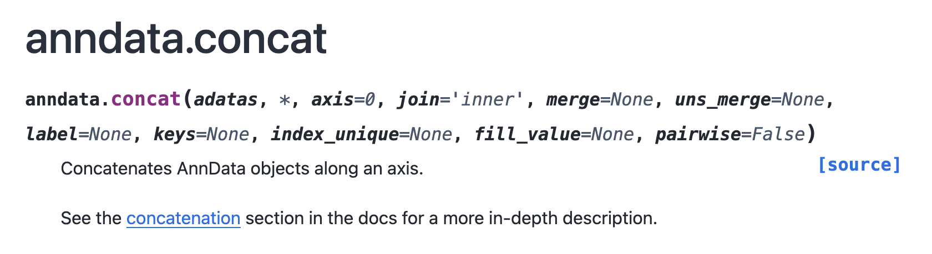
Loading multiple data in Scanpy
fill_value = 0
In case you set join = “outer”, there might be certain genes (e.g. X) that are not expressed in at least one of the data (e.g. d1). But you want to include that gene in your combined data. What value do you assign for gene X in data d1? By default it is NaN and can cause problems downstream, so we set fill_value = 0.
join = “outer” or “inner”
outer = all genes expressed in at least one of the data sets
inner = all genes expressed in all of the data sets
** Issue can occur for example in knockouts or transgenes

Slide 6
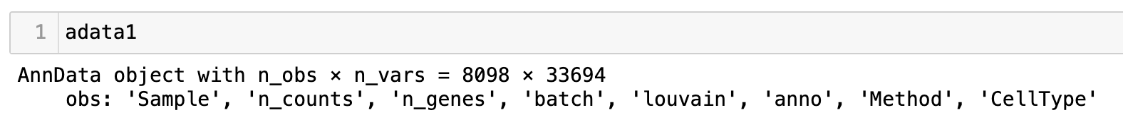
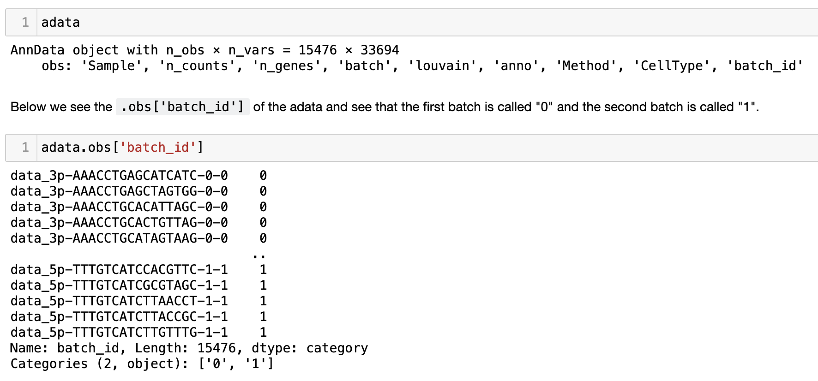
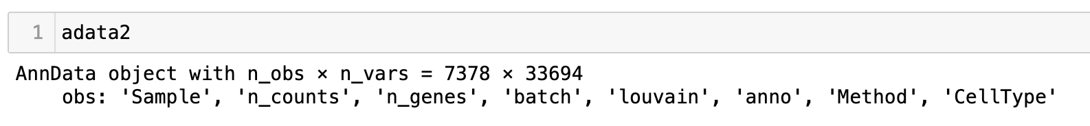
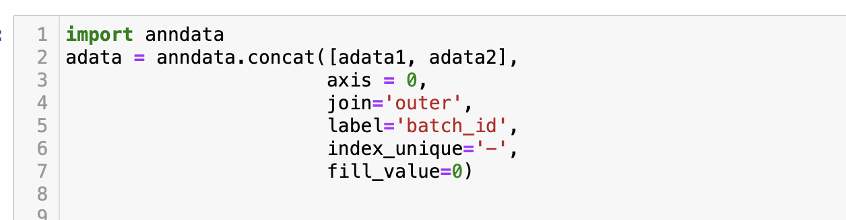
Loading multiple data in Scanpy

Slide 7
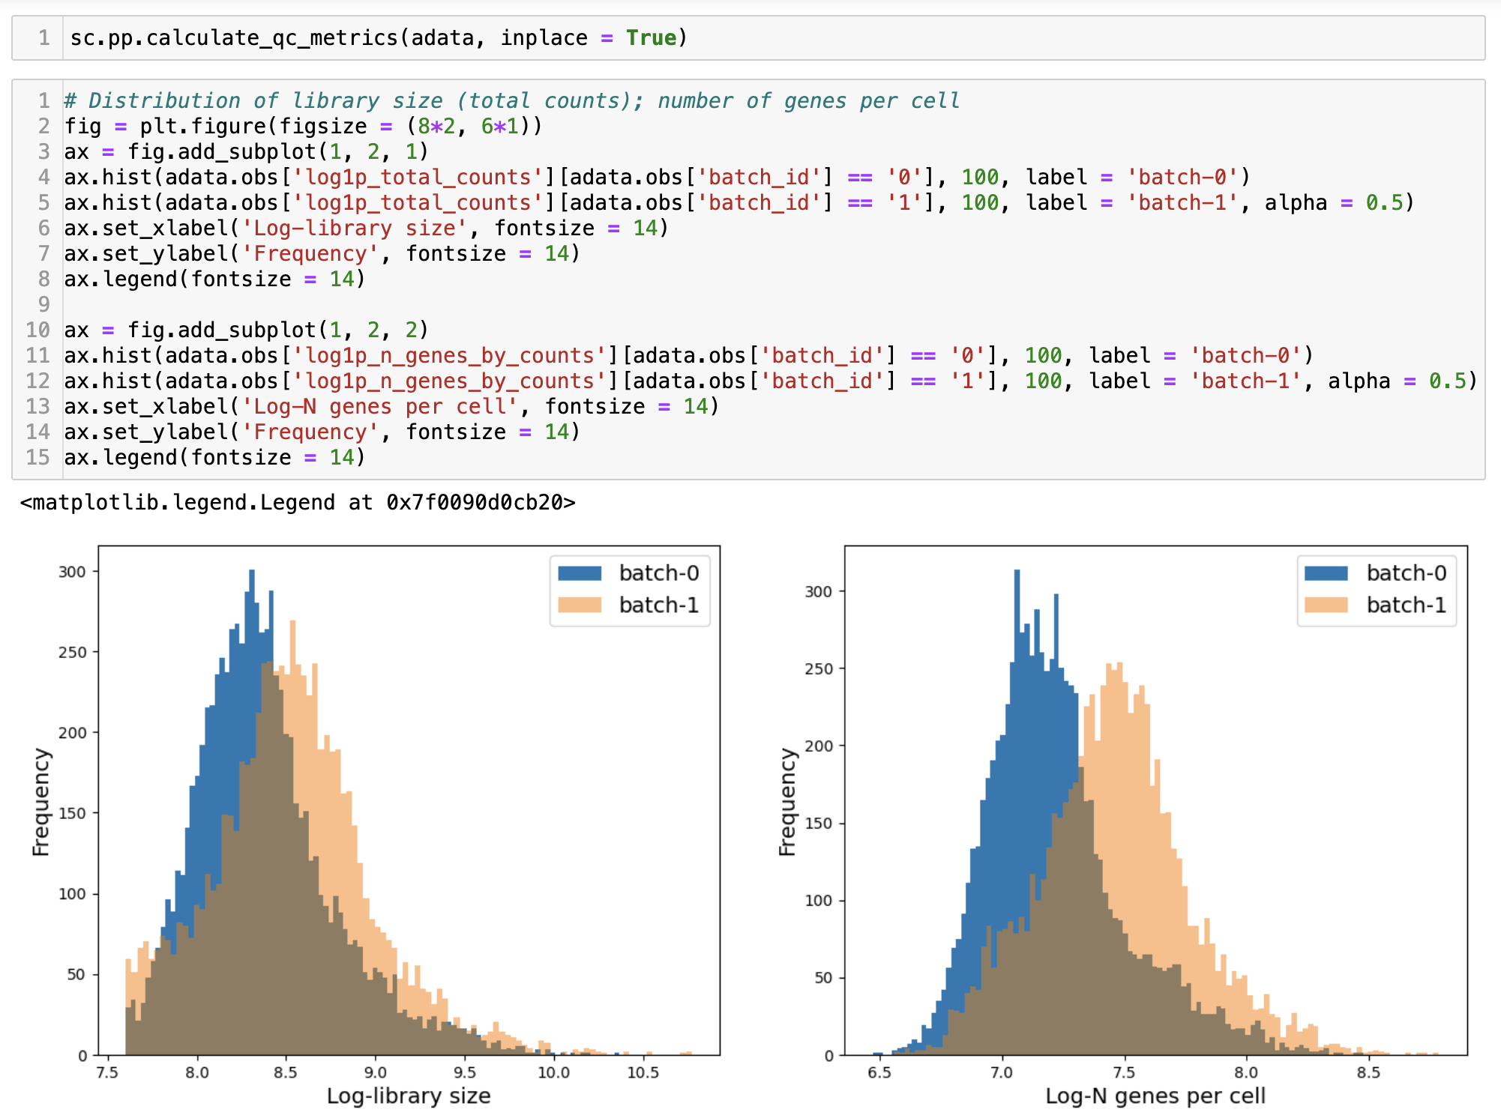
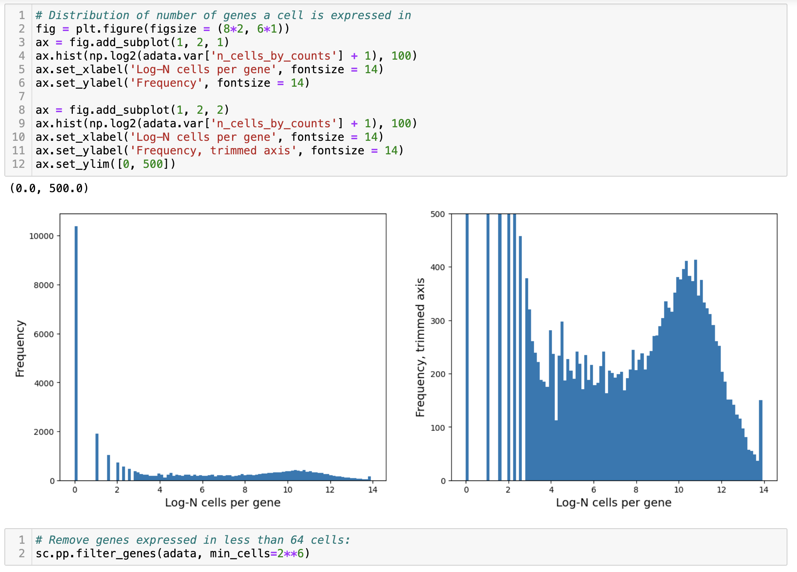
Analyze the combined data

Slide 8
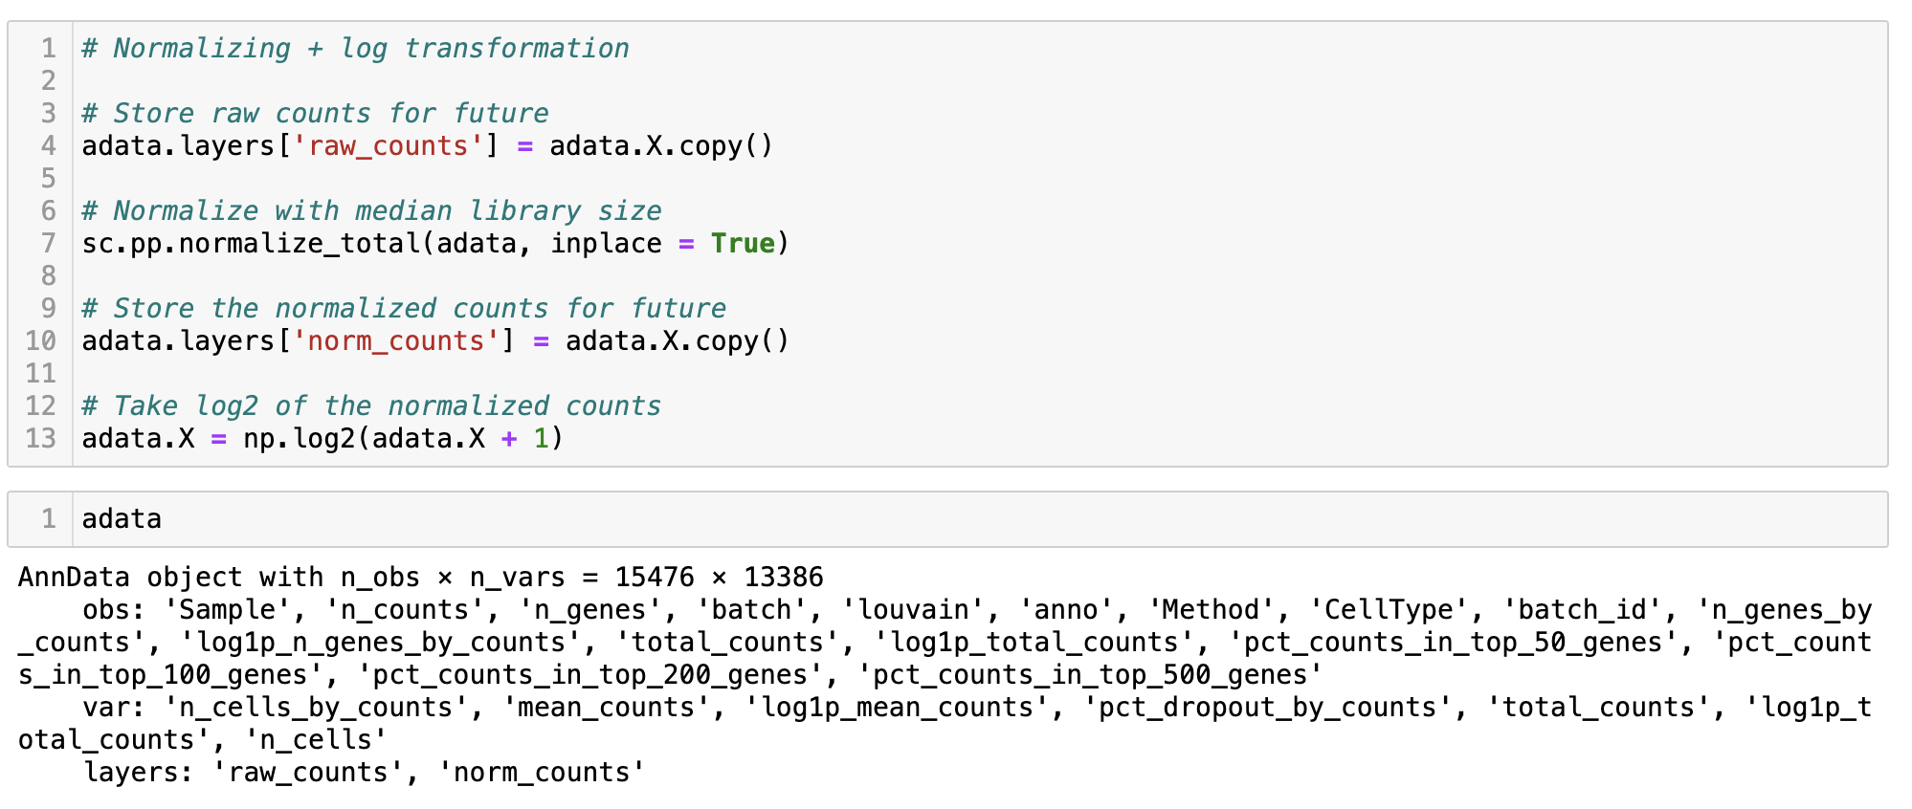
Analyze the combined data

Slide 9
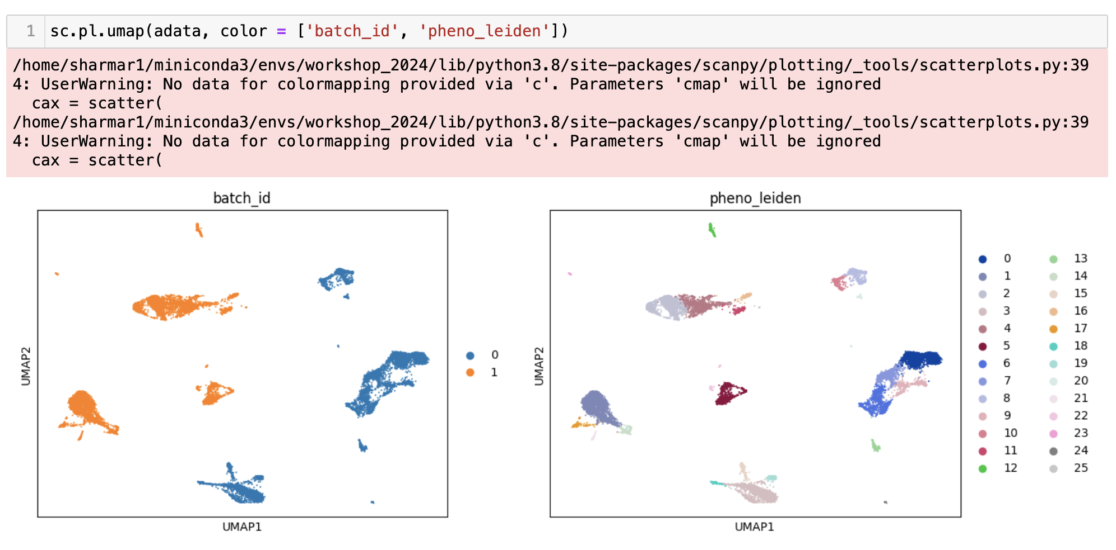
Analyze the combined data
The cell distribution seem to be driven by batch. In other words, there seems to be strong batch effect present in the data.

Slide 10
Batch effect
Batch effect refers to differences between samples as a result of non-biological confounders such as sequencing depth, differences in time of collection etc.
What causes batch effect in bulk RNA-seq data can also cause batch effect in single-cell RNA-seq data
Since the differences are not biologically driven, it is important to correct for the differences
Batch effect correction: Computational tools to correct for batch effects.
But before: How to identify if there is batch effect?

Slide 11
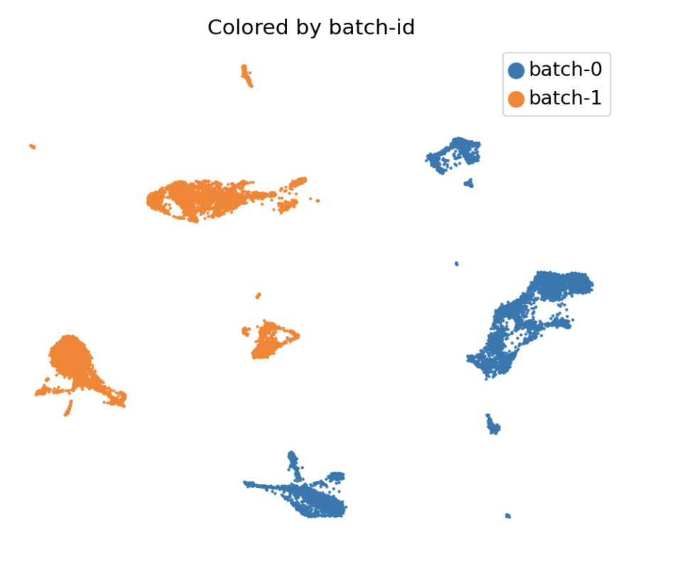
Observing batch effect - 1
Make UMAP/FDL and color by batch-id; compare with known information
Know these are both healthy PBMC
Simply collected using different technology
There must not be such striking difference only due to the batch-id

Slide 12
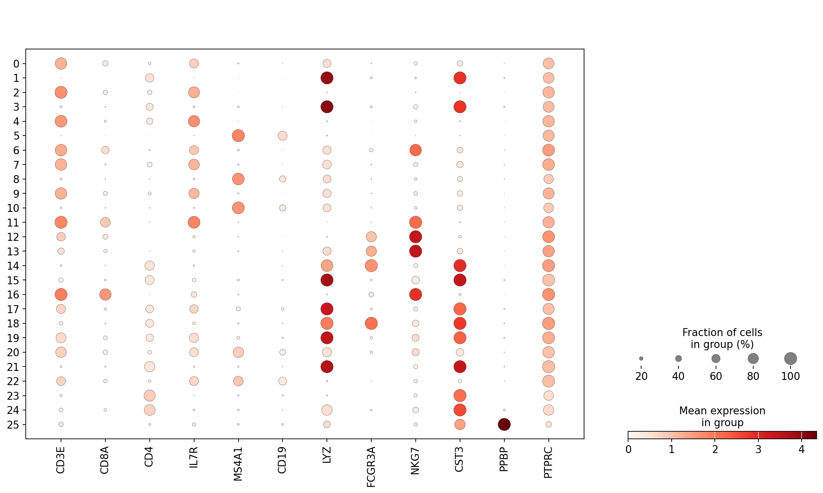
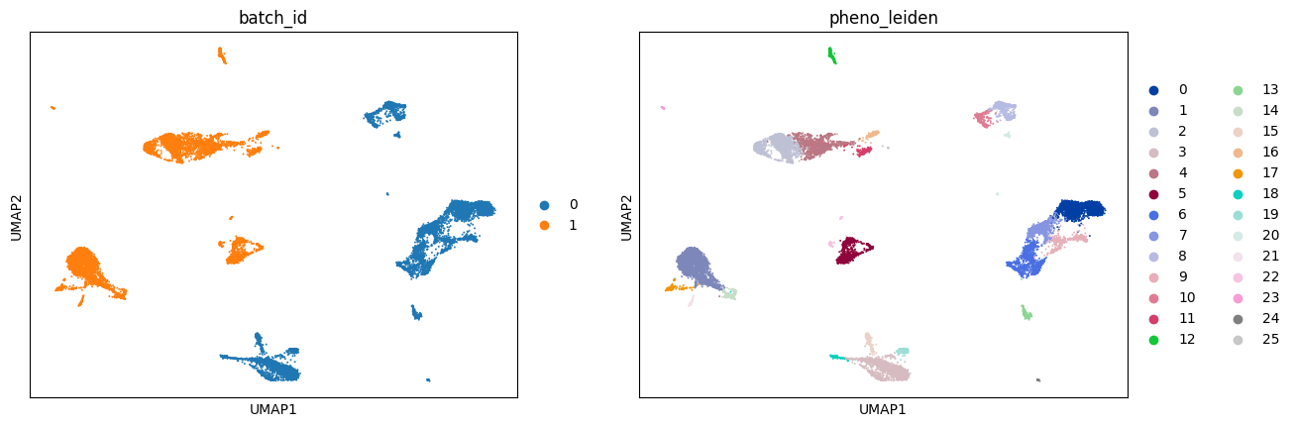
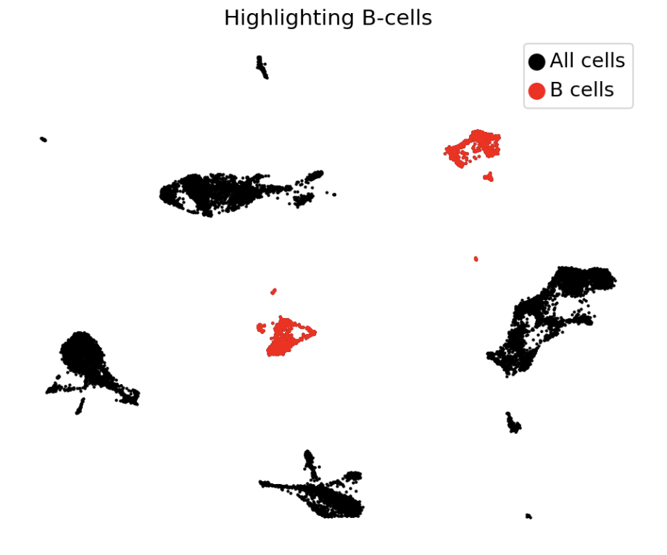
Observing batch effect - 2
Studying differentially expressed genes

Slide 13
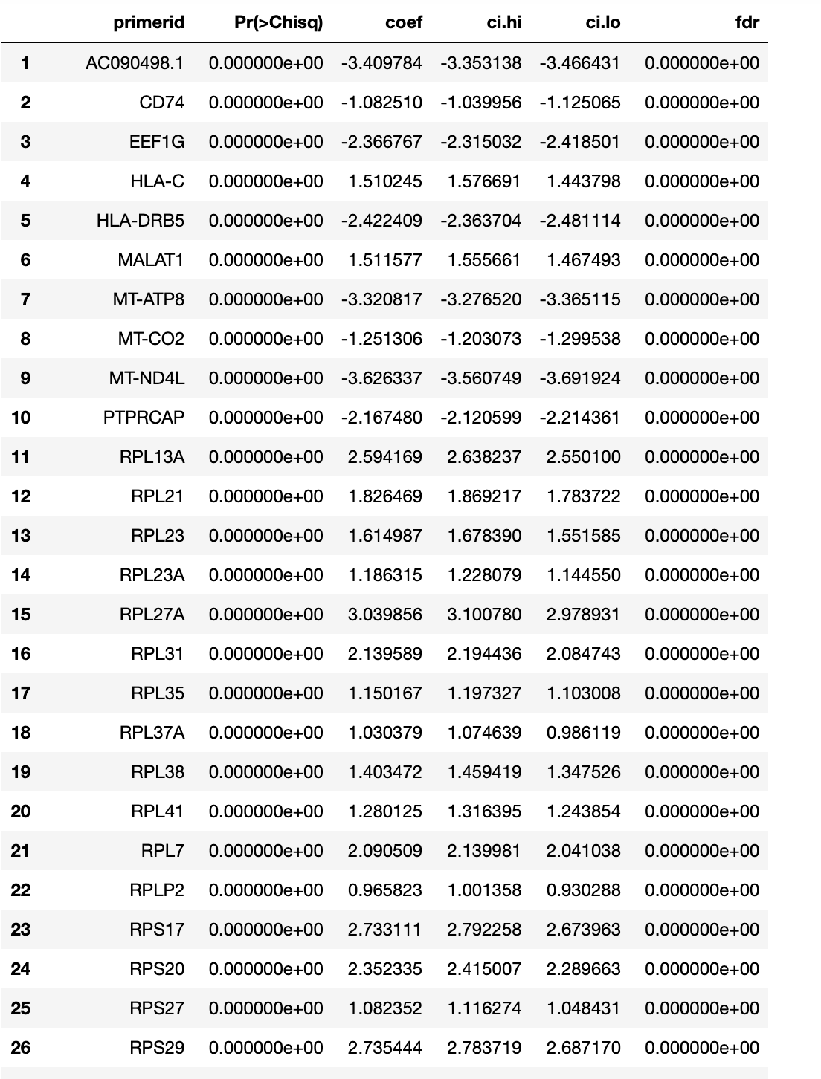
Observing batch effect - 2
Studying differentially expressed genes
Top differentially expressed genes between B-cells in batch1 vs B-cells in batch2.
Most of the top ranking genes are ribosomal genes
Indicates that the difference between B-cells in the two batches is likely nuisance (or at least majority of the effect occurs among house keeping genes)
Suggests the presence of strong batch effect!

Slide 14
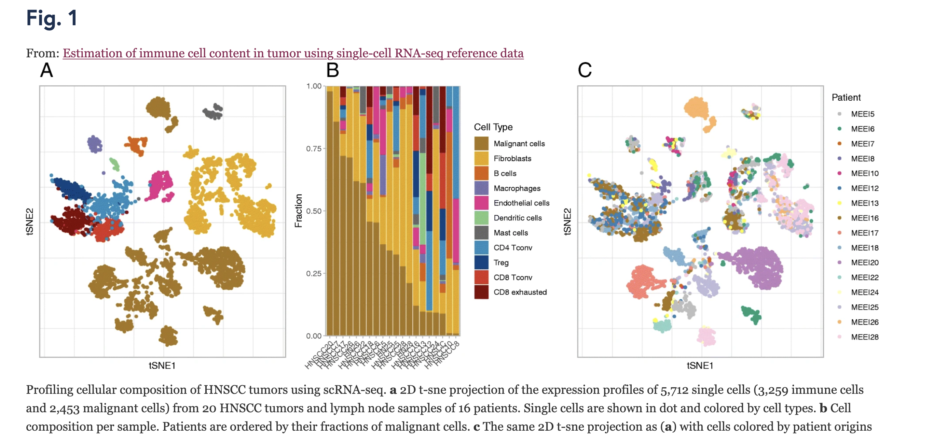
Observing batch effect - 3
Studying effect on different types of cells
https://bmccancer.biomedcentral.com/articles/10.1186/s12885-019-5927-3

Slide 15
Batch effect correction
Once sure that there is batch effect, how do we correct for it?
Many methods have been proposed - Benchmarked: https://genomebiology.biomedcentral.com/articles/10.1186/s13059-019-1850-9
We will discuss 2 of them:
Scanorama (Recommended)
Harmony
A common thread in many batch effect correction methods:
Identify cells with the same phenotype across batches
Use them to quantify the batch effect correction vector
Correct

Slide 16
Clarification
Batch effect correction
Data Alignment
The goal here is to correct for the batch effect
End result is a set of corrected gene expression matrices
Plus, embedding of cells from all batches in a lower dimensional space (can be thought of as a corrected principal component space)
The corrected gene expression matrices can be carefully used for downstream processing
Any results using these genes (e.g. DEG) should be validated on original counts as well
The goal here is to align the data sets in a suitable space
Usually, methods that align data do not correct the gene expression matrices
Only provide an embedding of cells from all batches in a lower dimensional space (can be thought of as a corrected principal component space)
The output cannot be used for downstream analysis such as differential expression analysis

Slide 17
Scanorama

Slide 18
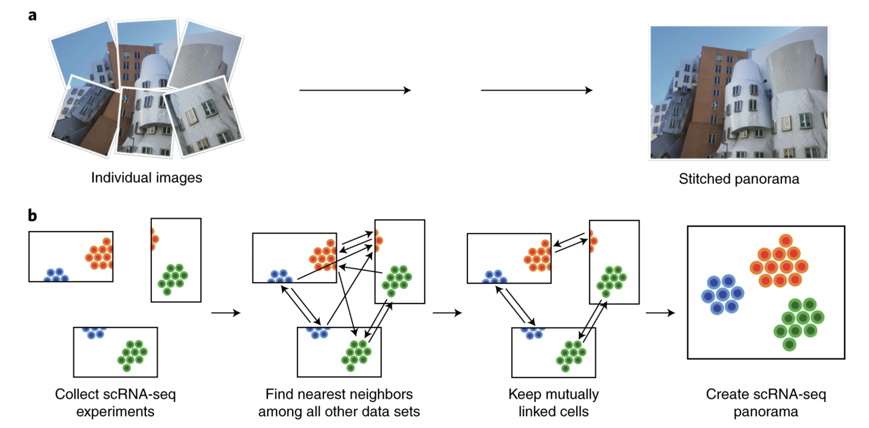
Scanorama

Slide 19
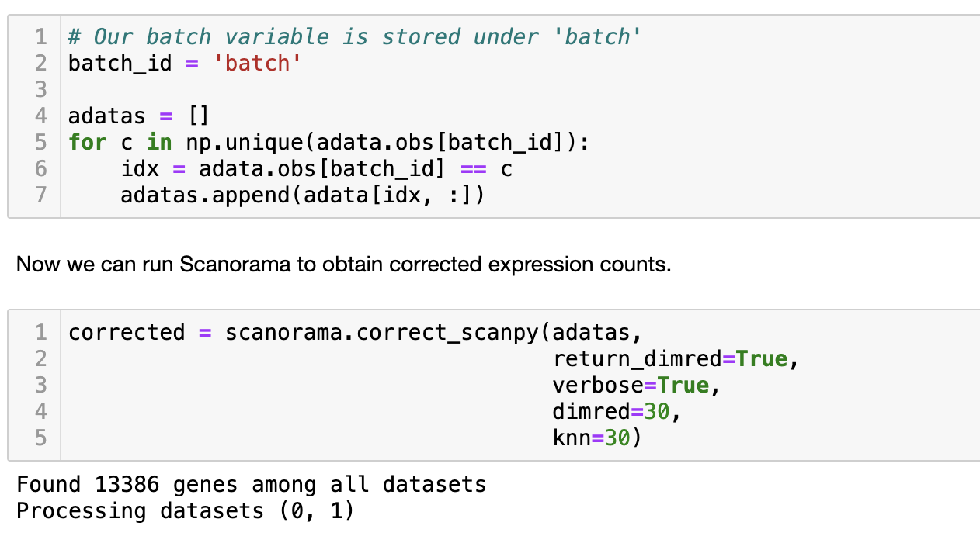
Scanorama
Scanorama identifies mutually nearest neighbors (MNN) in all pairs of data sets
Once the MNN have been identified, Scanorama uses them to compute translation vector and corrects for batch effect
Scanorama is better when you have more than 2 batches
return_dimred = True implies that the method will return the reduced dimensions (like PCA) where the two batches have been co-embedded or co-aligned.
dimred = 30 is the number of dimensions on which Scanorama will perform the cell nearest neighbor matching.
knn = 30 is the number of nearest neighbors to estimate.
Note: There is another parameter called hvg to specify the number of highly variable genes (automatically estimated by scanorama). If you specify this number, the output matrix will only be corrected with highly varying genes (i.e. not all the genes).

Slide 20
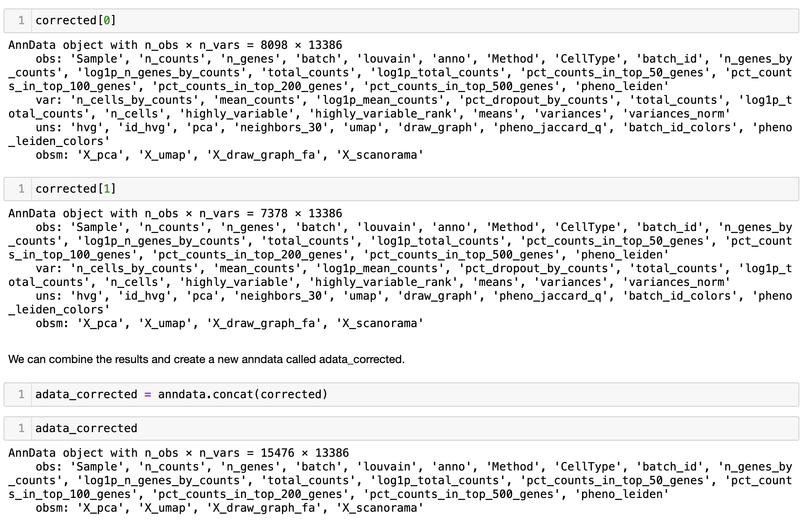
Scanorama

Slide 21
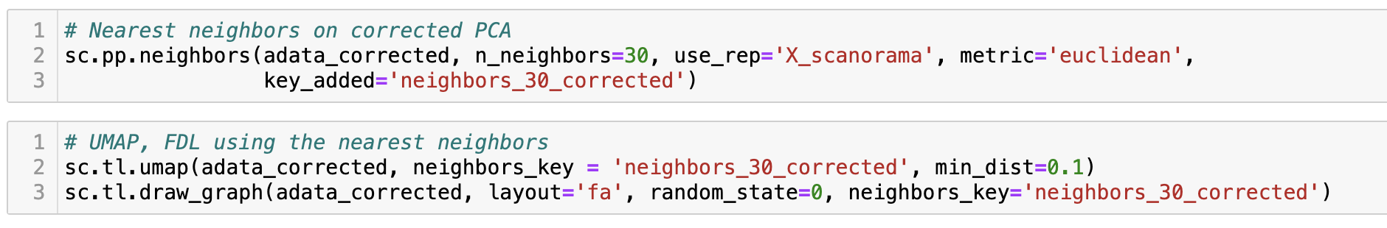
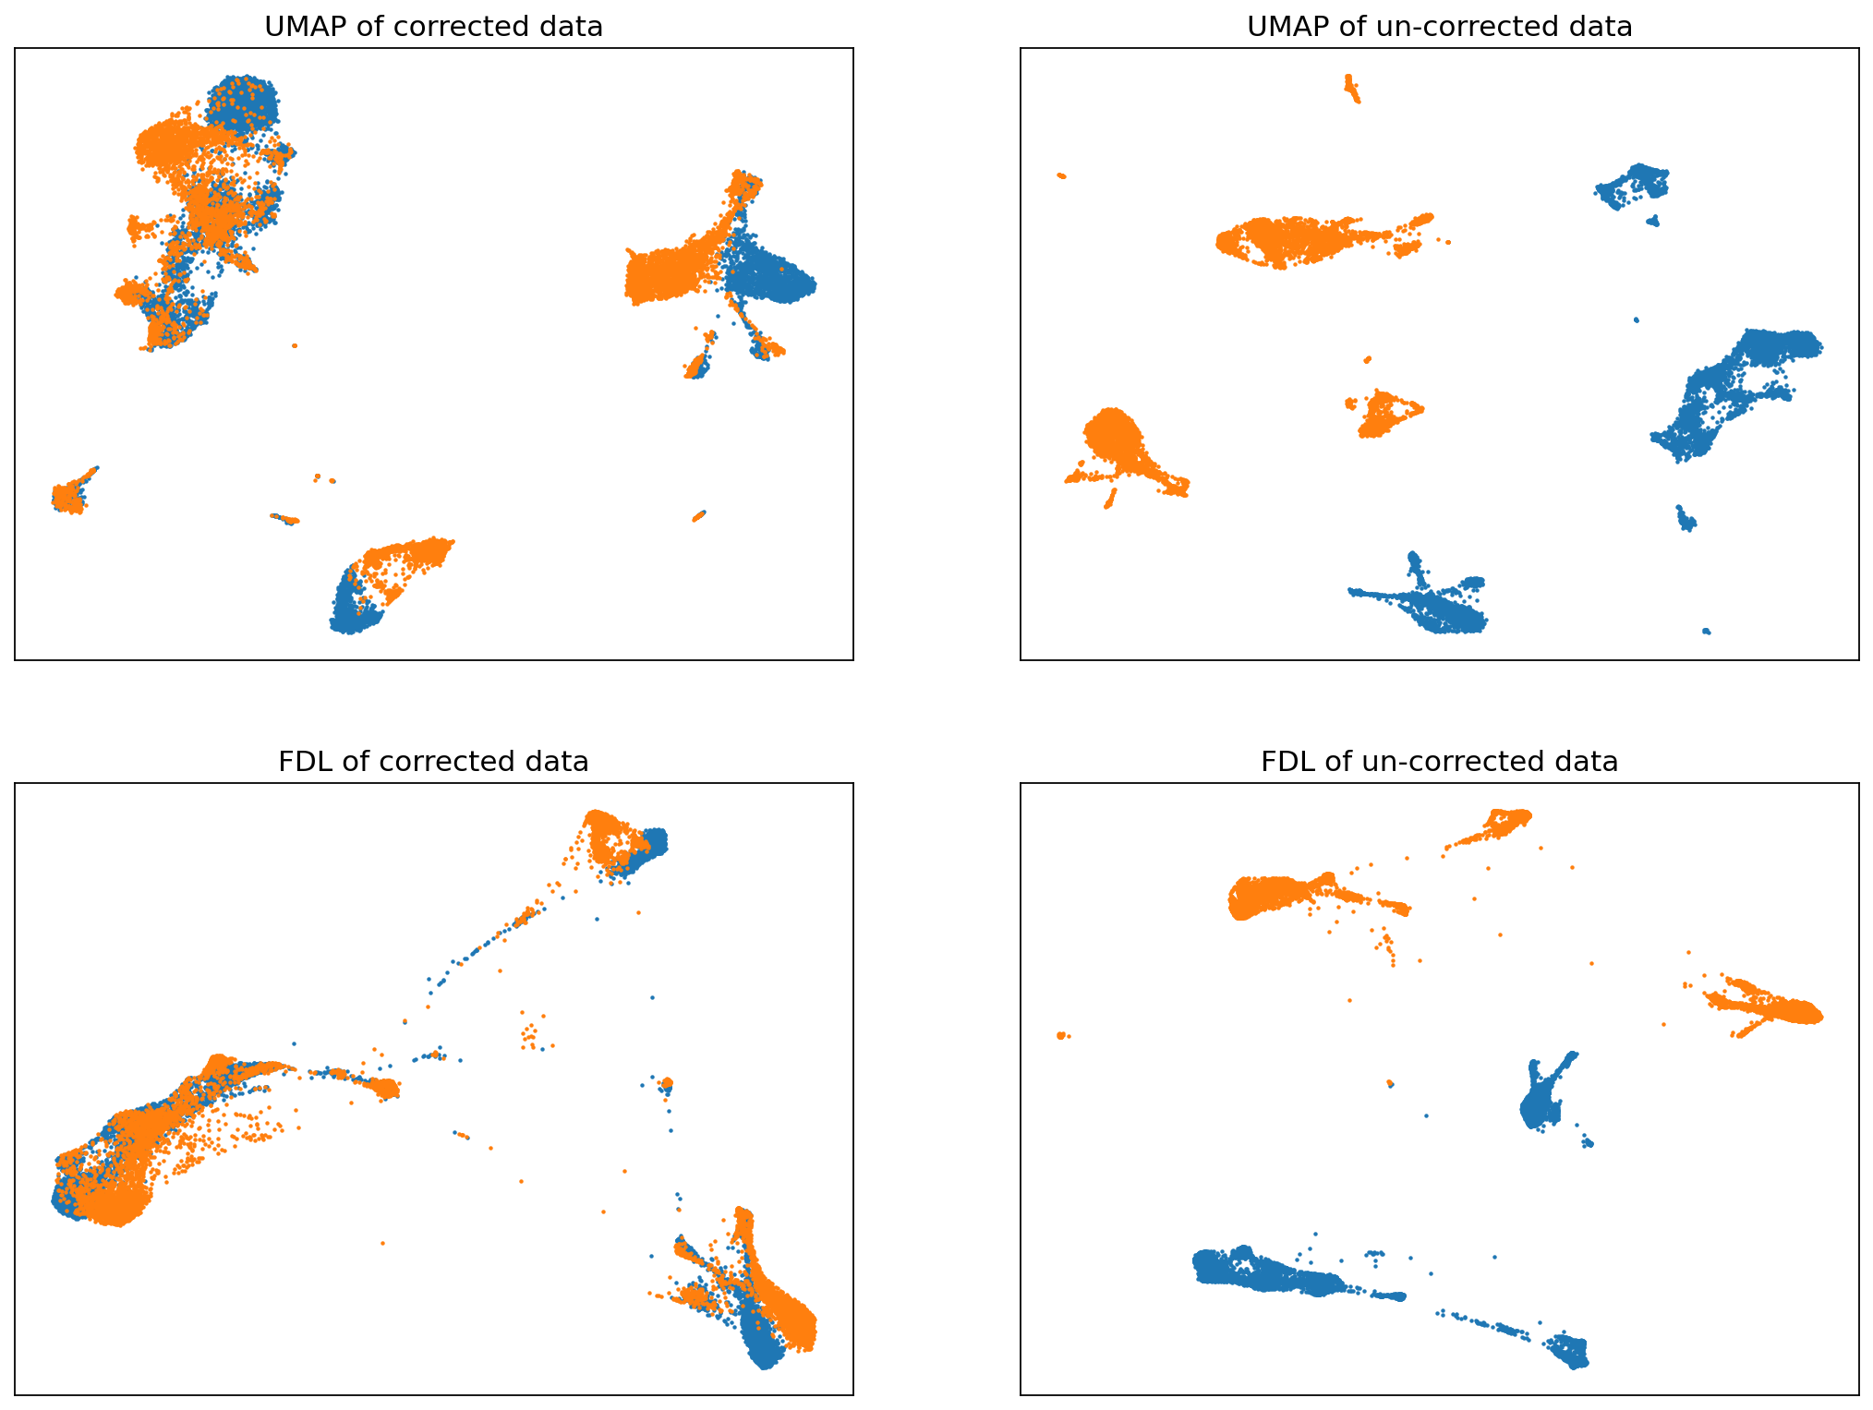
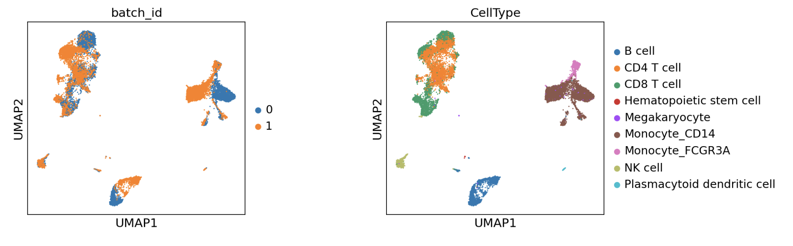
Scanorama

Slide 22
Harmony

Slide 23
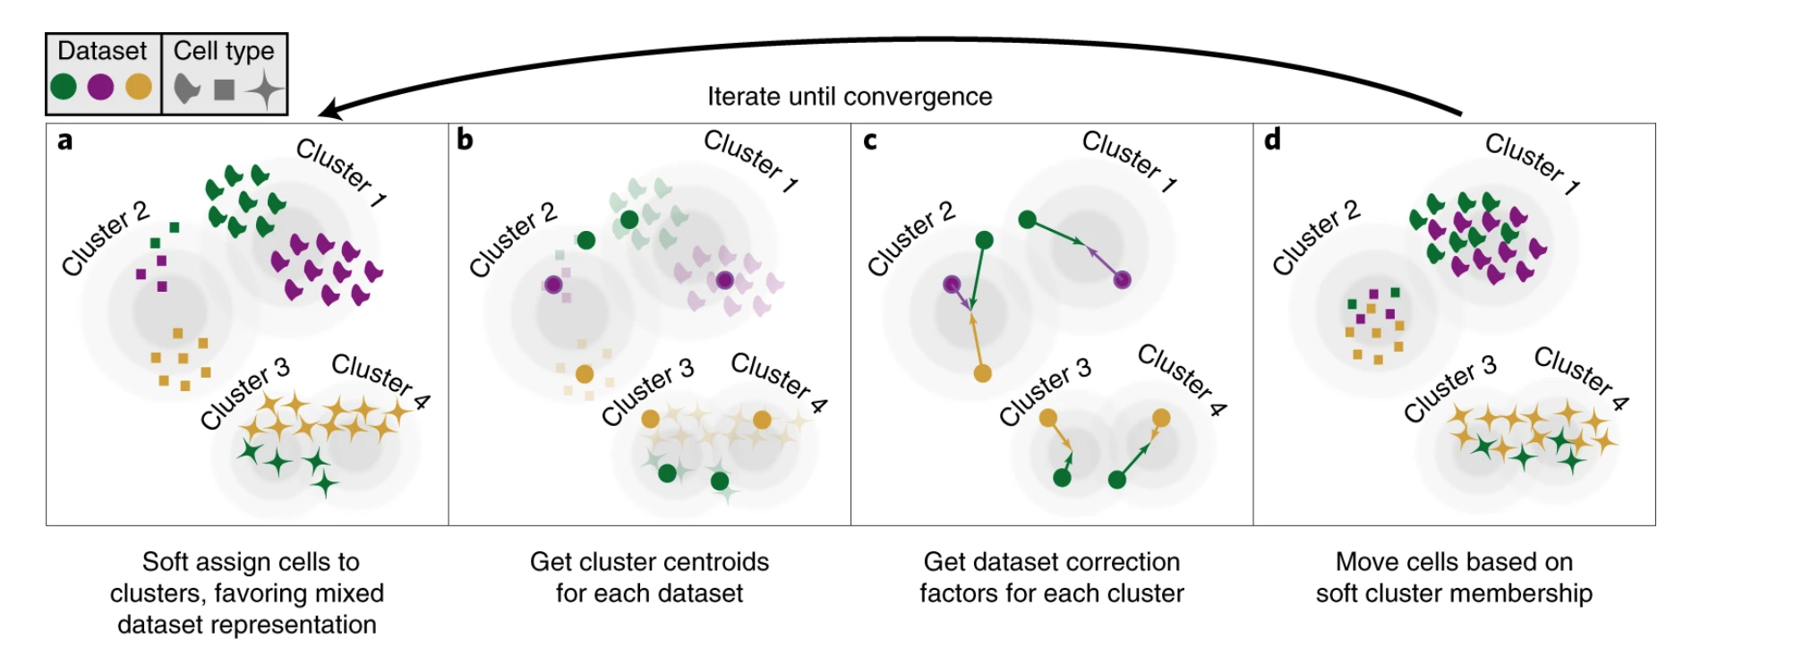
Catch:
Harmony only operates in the PCA space
Implies, it can alter non-linear features of the data
Does not return corrected expression matrices

Slide 24
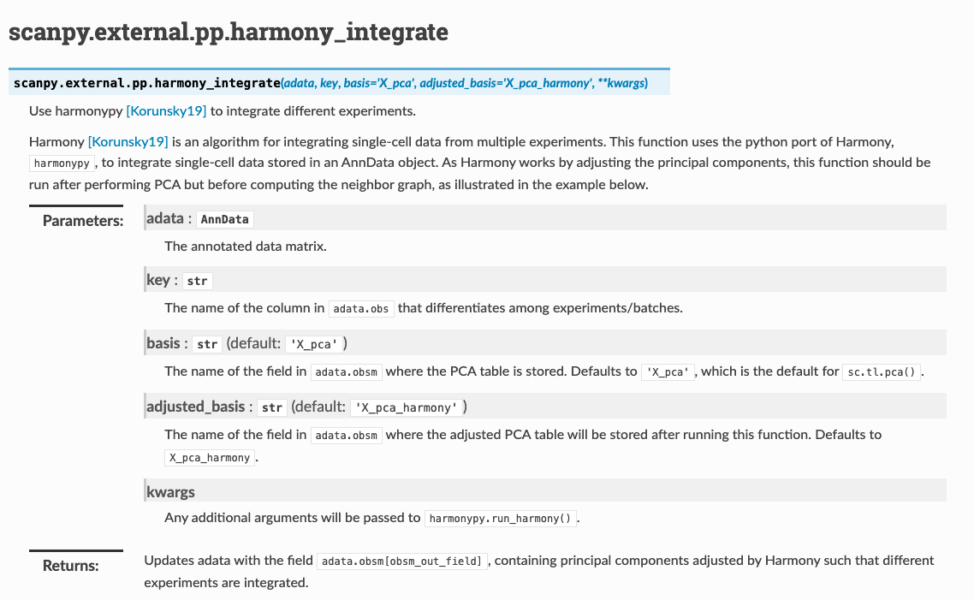
Harmony

Slide 25
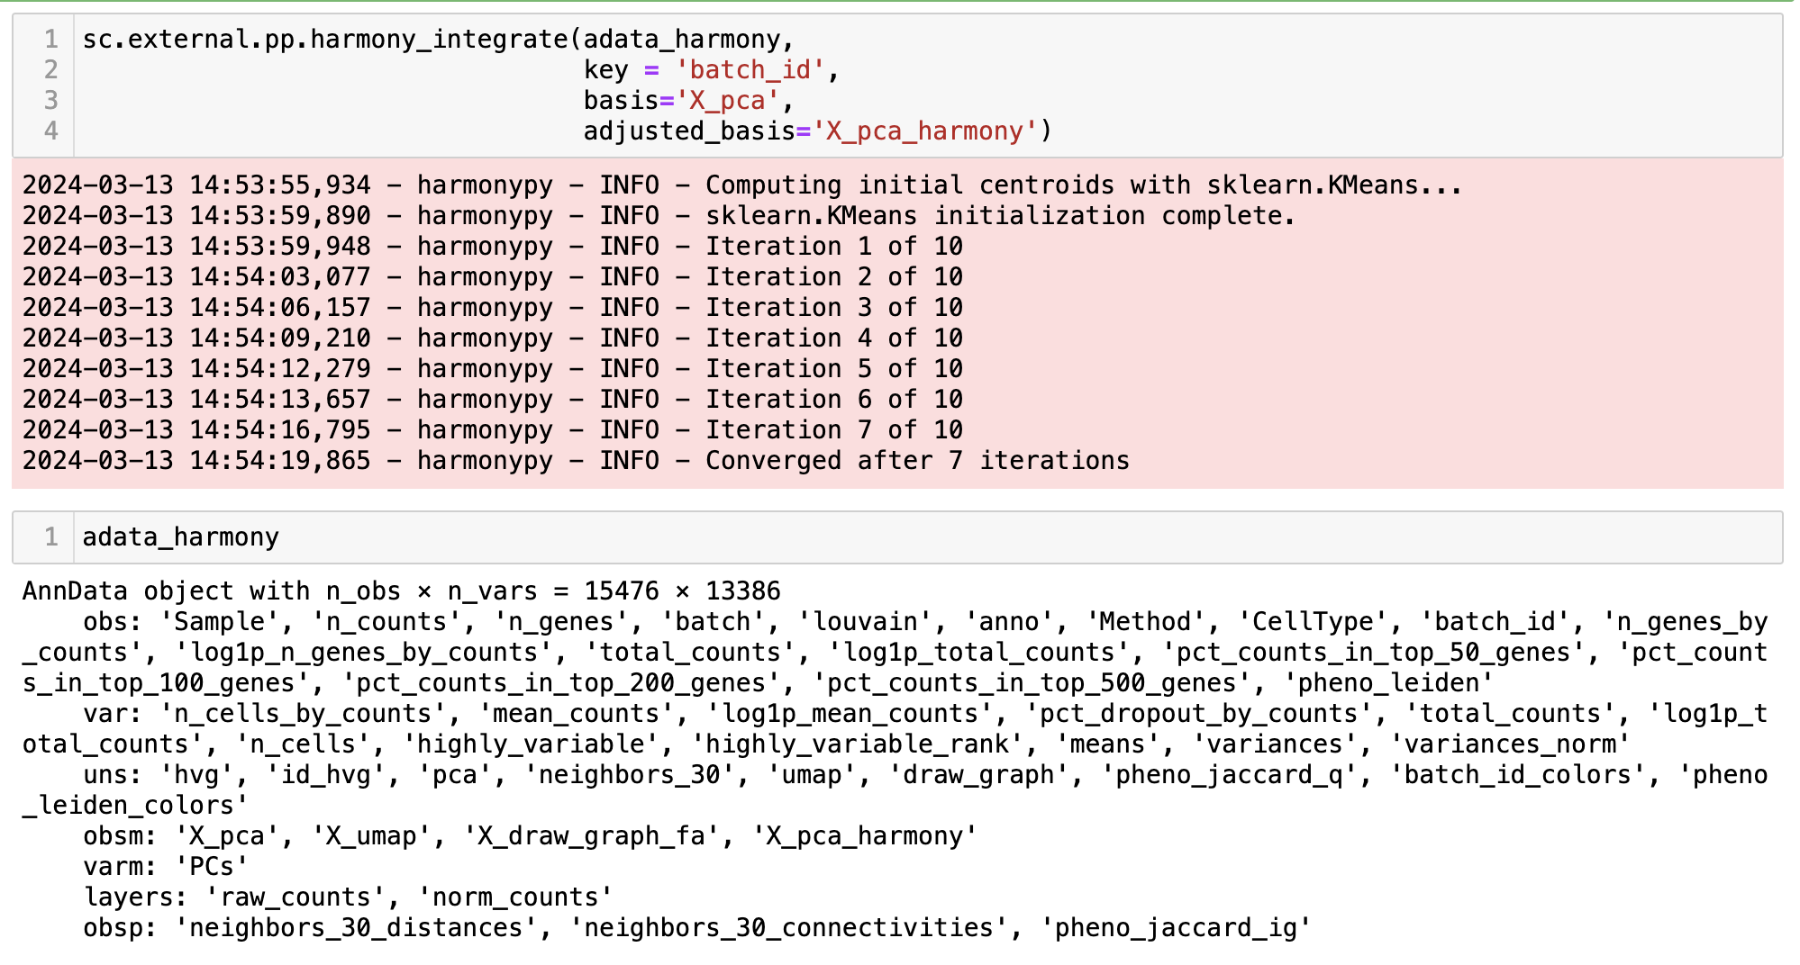
Harmony

Slide 26
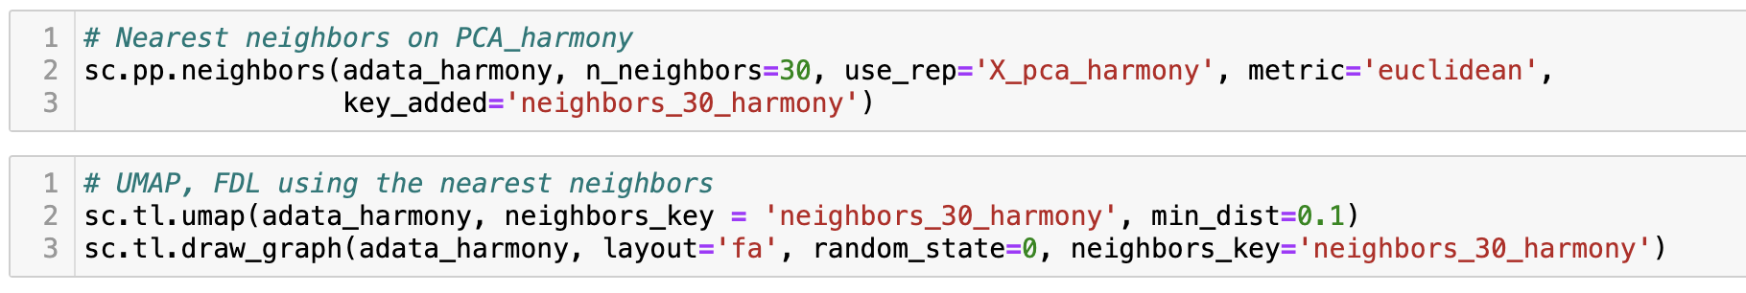
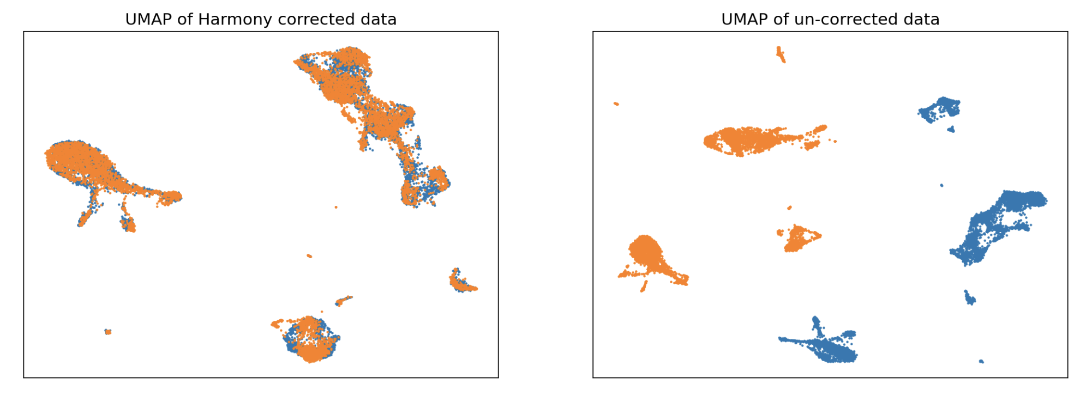
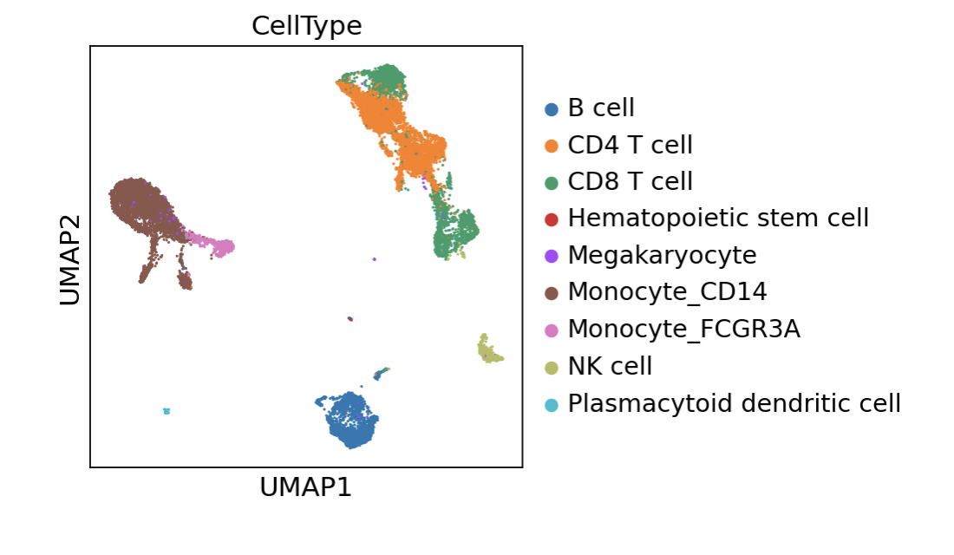
Harmony

Slide 27
Recap
Library size distribution; Number of uniquely expressed genes per cell
scRNA-seq data matrix
Pre-process and QC
Number of cells each gene is expressed in
Visualization: tSNE, UMAP, Force Directed Layout
MT-content
Doublet Detection
Clustering: PhenoGraph, Leiden
Graph
PCA, dimensionality reduction
Data Normalization (Median library size + log transformation)
Imputation
Differential Expression, GSEA
Trajectory Inference, Factor Analysis
Multisample

